Slide 1
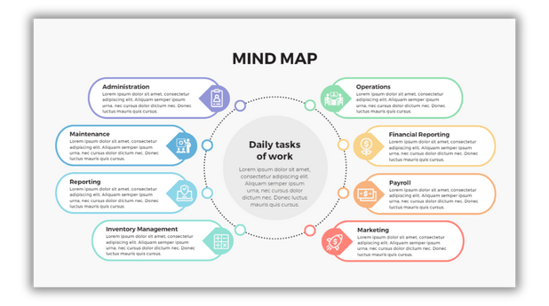




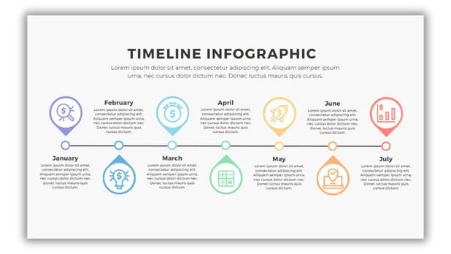








AERO.NET
Elevating connectivity beyond the horizon

Slide 2













AGENDA
structured outline of topics and activities to be covered in this presentation.
Introduction
Our Team
Problem Statement
& Solution
Key Feature
Product Backlog
Brief overview of the presentation's objectives, sets the context for the discussion, and outlines what will be covered.
Meet the team driving the Aero.net Telecom Management System project, showcasing our expertise and roles in delivering innovative telecom solutions.
Identifying the key inefficiencies and challenges in managing customer profiles, plan details, and call records within the current telecom system.
Highlighting the main functionalities of the Aero.net Telecom Management System, including customer management, plan handling, and call details tracking.
A prioritized list of tasks and features to be developed for the Aero.net Telecom Management System, detailing upcoming work and improvements.
Code Snippet
OutPut
Future Enhancement & Conclusion
A sample of the code used in the Aero.net Telecom Management System to illustrate key functionalities or implementations.
Demonstrating the results and data produced by the Aero.net Telecom Management System, showcasing its functionality and performance.
Outlining planned improvements for the Aero.net Telecom Management System and summarizing the project's impact and next steps.

Slide 3

INTRODUCTION
Brief overview of the presentation's objectives, sets the context for the discussion, and outlines what will be covered.
The Aero.net Telecom Management System is a Spring Boot application designed to streamline the management of customer profiles, telecom plans, and call details. Utilizing SQL for reliable data storage and Swagger for API documentation, this project enhances operational efficiency and improves customer service by providing a centralized, user-friendly platform for managing and accessing essential telecom data.

Slide 4







OUR TEAM
Meet the team driving the Aero.net Telecom Management System project, showcasing our expertise and roles in delivering innovative telecom solutions.
01
02
03
04
05
LOHITHA PANCHADARLA
VARSHA MYDHILI
SOUMYA JAKKAM
SAKSHI
SHANMUKHA SAI

Slide 5



PROBLEM STATEMENT
Identifying the key inefficiencies and challenges in managing customer profiles, plan details, and call records within the current telecom system.
01
03
INEFFICIENT CUSTOMER MANAGEMENT
INADEQUATE PLAN DETAILS HANDLING
The system struggles with managing customer details effectively.
The system fails to support efficient CRUD operations for plan details.
02
04
LIMITED CALL DATA RETRIEVAL
LACK OF ANALYTICAL FUNCTIONALITY
The system hinders retrieval of call details by date.
The system lacks capabilities for calculating call durations and frequencies.

Slide 6



SOLUTION
Implementing a comprehensive system to enhance CRUD operations, improve call data retrieval, integrate data management, and provide advanced reporting and insights.
01
02
03
Enhanced CRUD Operations
Advanced Call Data Retrieval
Integrated Data Management
Implement a robust system for seamless creation, retrieval, updating, and deletion of customer profiles, telecom plans, and call records.
Introduce capabilities to fetch call details by date and perform detailed analysis, including calculating call durations and frequencies.
Centralize customer, plan, and call data into a unified system to eliminate inefficiencies and improve accessibility.

Slide 7






Customer Management
Efficiently view and monitor a complete list of all customers, and retrieve detailed customer information using either their name or unique Customer ID.
Plan Management
Access and review all available plans, introduce new strategic plans, update existing plans, and manage plan details by fetching or deleting plans using Plan ID or name.
KEY
FEATURES
Highlighting the main functionalities of the Aero.net Telecom Management System, including customer management, plan handling, and call details tracking.
Call Details Management
Monitor comprehensive call history, add new call records, and retrieve specific call details by Call ID. Additionally, analyze call statistics including total duration and frequency for particular dates and times. this are the key features can we add some more key features to this system
Advanced Search and Filtering
Enable advanced search and filtering options for customers, plans, and call records to facilitate quick and precise data retrieval.

Slide 8
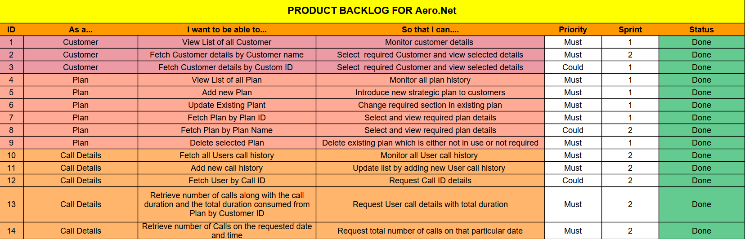
PRODUCT BACKLOG
A prioritized list of tasks and features to be developed for the Aero.net Telecom Management System, detailing upcoming work and improvements.

Slide 9
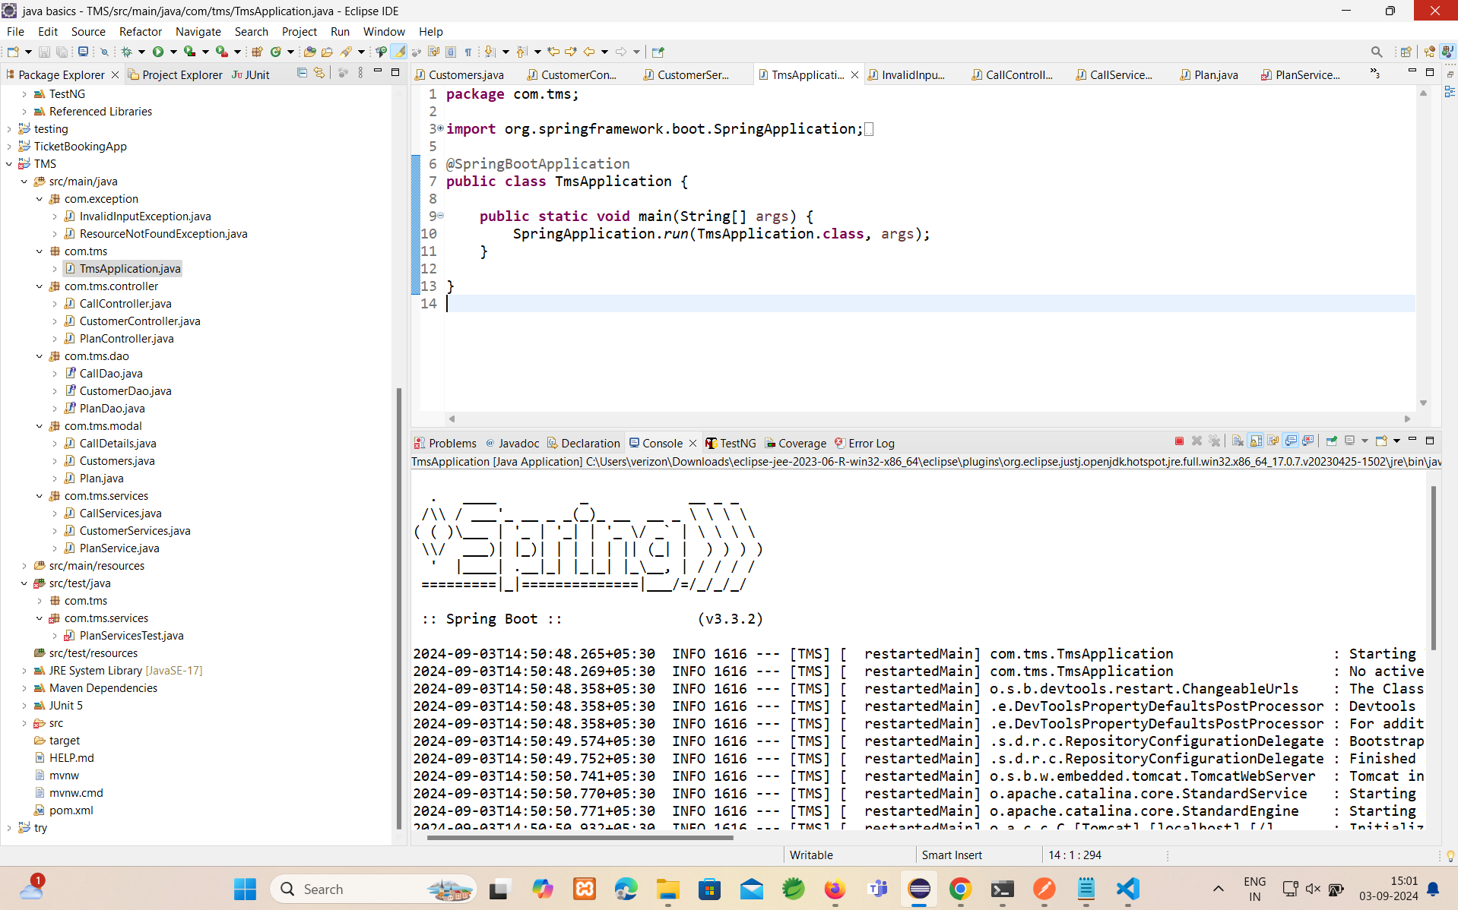
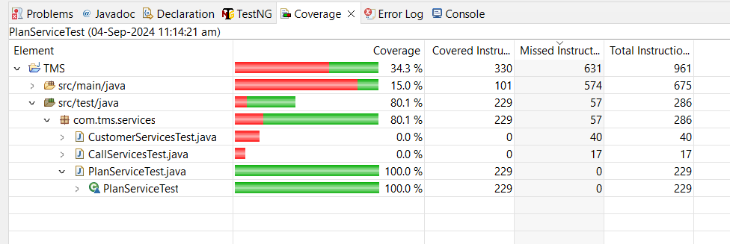
CODE &
DATABASE SNIPPET

Slide 10
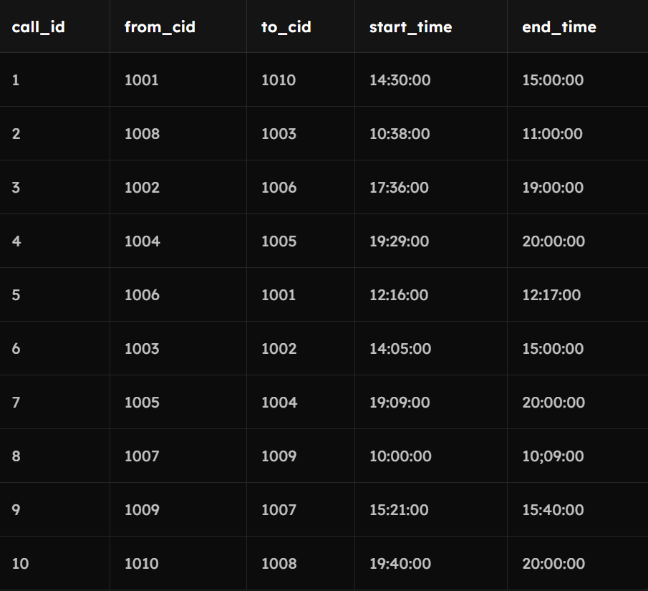
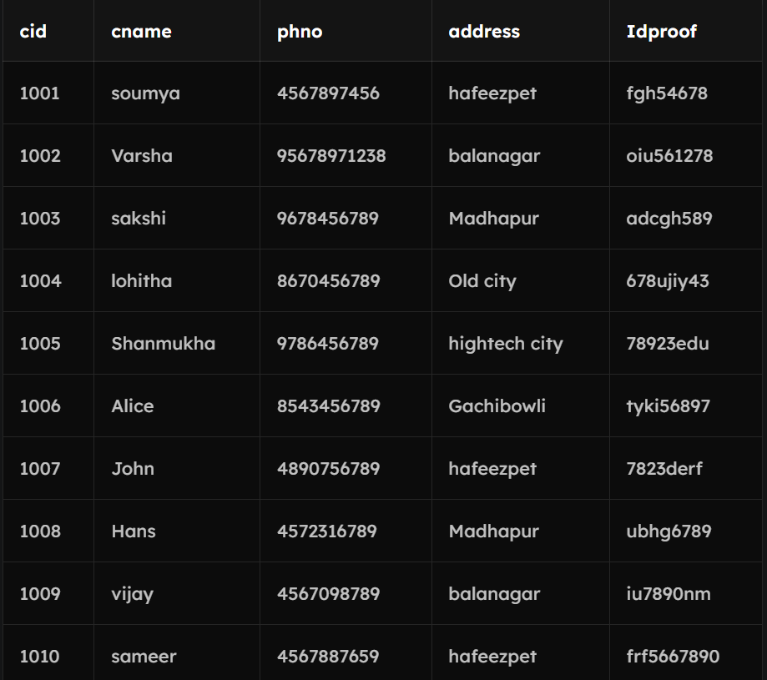
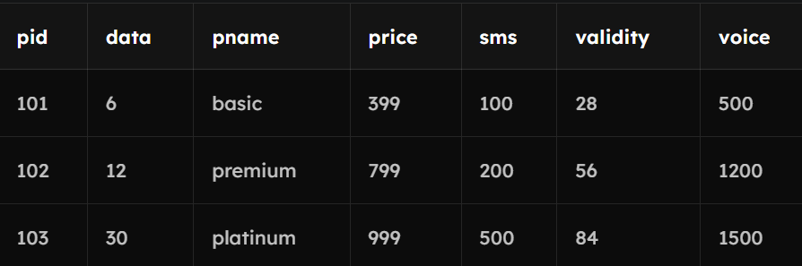
CODE &
DATABASE SNIPPET

Slide 11
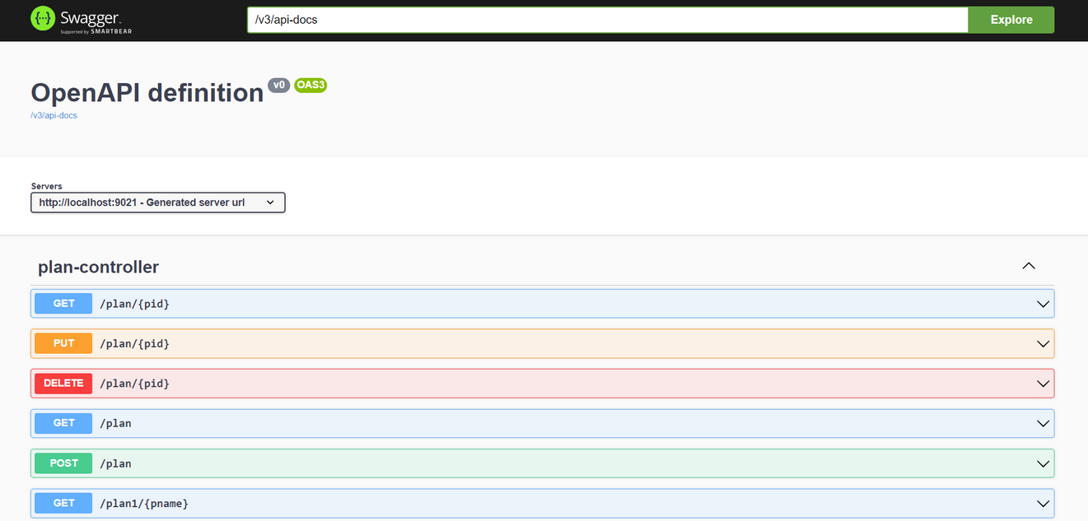
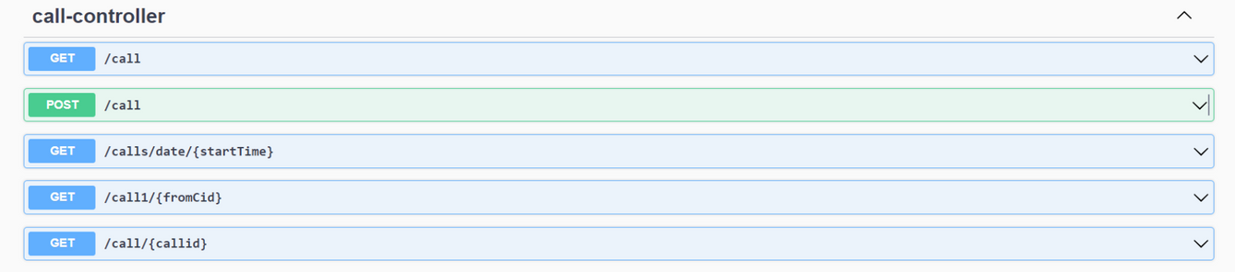
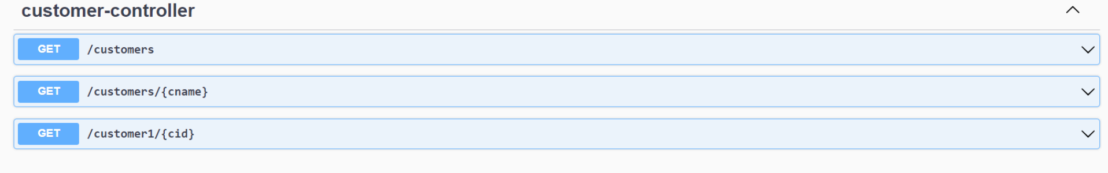
SWAGGER SNIPPET

Slide 12









FUTURE ENHANCEMENT
Outlining planned improvements for the Aero.net Telecom Management System and summarizing the project's impact and next steps.
Predictive Analytics
Integrate machine learning to forecast call usage and customer behavior for improved planning and management
Multi-Language Support
Add localization and multi-language support to cater to a global user base.
Automated Alerts
Mobile and Web Enhancements
Implement automated notifications for key events and anomalies in call patterns, product updates, and customer status.
Create mobile and web application interfaces for better usability and access to call, product, and customer details.

Slide 13
CONCLUSION
Summarize how the Aero.net Telecom Management System addresses key challenges, enhances functionality, and sets the stage for future improvements.
The Aero.net Telecom Management System is designed to address key inefficiencies in managing customer, plan, and call data. By implementing robust features and planning future enhancements, the system will enhance operational efficiency, improve data accuracy, and deliver valuable insights, driving better decision-making and customer satisfaction.

Slide 14
Thank
you!

